Slide 1
Algorithms and Data Structures - Part II
ANALYSIS OF ALGORITHMS

Slide 2
Asymptotic Analysis of Algorithms

Slide 3



Resources
Operations
The number of times we need to perform some operations
Memory
How much memory is consumed by the algorithms
Others
Network transfer, compression ratios, disk usage

Slide 4
char[] letters = ”ABCDEFGHIJKLMNOPQRSTUVWXYZ";
int index = 0; while(letters[index] != 'G')
index++;
A B C D E F G H I J K L M N …
1 + 1 + 1 + 1 + 1 + 1 + 1 = 7
… n

Slide 5
Big-O Notation

Slide 6
O(n)

Slide 7
How Does the Algorithm Scale?
Cost
n

Slide 8
Asymptotic Analysis

Slide 9
Asymptote
The asymptote of a curve is a line where the distance between the curve and the line approach zero as they tend towards infinity.

Slide 10
Big numbers are more interesting

Slide 14
What is the upper limit?

Slide 15
It depends
(Hint: look at your domain)

Slide 16
O(n+1) is O(n)

Slide 17
O(2n) is O(n)

Slide 18
Big-O Examples

Slide 19
O(1)
The cost of the algorithm is unchanged by the input size.

Slide 20
O(1) Growth
Input Size | Cost
1 | 1
100 | 1
1000 | 1
1000000 | 1

Slide 21
O(n)
A function whose cost scales linearly with the size of the input.

Slide 22
char[] letters = "abcdefghijklmnopqrstuvwxyz";
for(int i = 0; i < letters.Length; i++) { Console.WriteLine(letters[i]);
}
O(n)
Iterating over a collection of data once often indicates an O(n) algorithm.

Slide 23
O(n) Growth
Input Size | Cost
1 | 1
100 | 100
1000 | 1000
1000000 | 1000000

Slide 24
O(log n)
A function whose cost scales logarithmically with the input size

Slide 25
O(log n)
aardvark
ocelot
zebra

Slide 26
O(log n)
aardvark
ocelot
zebra

Slide 27
O(log n)
aardvark
ocelot
elephant

Slide 28
O(log n)
aardvark
ocelot
elephant

Slide 29
O(log n)

Slide 30
O(log n)
giraffe

Slide 31
O(log n) Growth
Input Size | Cost
1 | 1
10 | 1
1000 | 3
1000000 | 6

Slide 32
O(n²)
A function that exhibits quadratic growth relative to the input size.

Slide 33
void quad(char[] input, int count) { for (int i = 0; i < count; i++)
for (int x = 0; x < count; x++) process(input, i, x);
}
O(n²)
A doubly-nested loop is an indication that you might have an O(n²) algorithm.

Slide 34
O(n²) Growth
Input Size | Cost
1 | 1
10 | 100
1000 | 1000000
1000000 | 1e+12

Slide 35
O(nm)
A function which has two inputs that contribute to the growth

Slide 36
void nm(char[] n, int nc, char[] m, int mc) { for (int i = 0; i < nc; i++)
for (int x = 0; x < mc; x++) process(n[i], m[x]);
}
O(nm)
A nested loop that iterates over two distinct collections of data might indicate an O(nm) algorithm.

Slide 37
Predicting behavior means understanding your domain.

Slide 38
Relative Timing
Big-O | Elapsed Time
O(1) | 1 ms
O(log n) | 6 ms
O(n) | 16.67 minutes
O(nm) | (16.67 * m) minutes
O(n²) | 11.57 days
O(n³) | 3.16888e7 years

Slide 39
This seems bad!

Slide 40
Best
Average
Worst
Big-O

Slide 41
Best
Average
Worst
Big-Ω
Big-O

Slide 42
Best
Average
Worst
Big-Ω
?
Big-O

Slide 43
So we just use Big-O

Slide 44
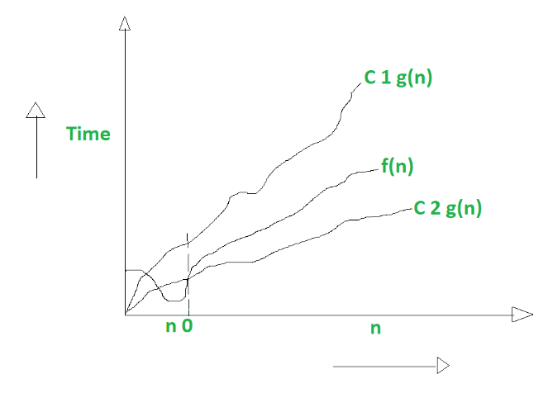
Big Theta (Θ)

